Slide 1
JAVA PROJECT • PROBLEM SOLVING USING PROGRAMMING
Blood Bank
Inventory &
Donor Matcher
A Java-based learning prototype for organizing donor details,
viewing blood stock, and demonstrating donor matching.
KL Deemed to be University
PRESENTED BY
N. Joshi • Maahir • Krishna Chaitanya
N. Joshi (2620090010) | Maahir (2620090064) | Krishna Chaitanya (2620080094)

Slide 2
Abstract & Project Overview
OVERVIEW
The project demonstrates how Java can support a simple blood-bank workflow through structured records, basic decision-making, and organized inventory.
THE NEED
OUR APPROACH
THE OUTCOME
Donor details and blood stock must be organized so information can be found clearly.
A menu-driven Java application models donor registration, stock viewing, and matching logic.
A modular academic prototype that connects programming concepts to a practical scenario.
The application is a learning model. Real donor eligibility and blood transfusion decisions require approved medical screening and procedures.
BLOOD BANK INVENTORY & DONOR MATCHER
02

Slide 3
Problem Statement & Objectives
OVERVIEW
PROBLEM STATEMENT
OBJECTIVES
Scattered or manually managed information can make it harder to review donor records, check stock by blood group, and organize responses to blood requests.
• Store donor information consistently
• Demonstrate simple input validation
• Display stock by blood group
• Search records for possible matches
• Apply Java CO1–CO6 concepts
Design focus: clarity, modularity, and an easy-to-follow console workflow.
BLOOD BANK INVENTORY & DONOR MATCHER
03

Slide 4
How It Works — Functional Workflow
SYSTEM DESIGN
A blood-request scenario, step by step
1
2
3
4
5
Choose
Record
Request
Check
Result
→
→
→
→
User selects an operation
Donor details are entered
Required blood group is entered
Inventory and records are searched
Available match or status is displayed
DECISION LOGIC
Conditions and loops guide the menu, search donor records, and check whether the requested group appears in inventory.
BLOOD BANK INVENTORY & DONOR MATCHER
04

Slide 5
CO1 — Basics, Data & Console I/O
CO1
JAVA CONCEPTS
PROJECT APPLICATION
• Primitive data types and variables
• Expressions and calculations
• Scanner input and console output
Collect donor ID, name, blood group, age, weight, and units donated; calculate an illustrative volume.
int age = 18;
double weightKg = 65.0;
int unitsDonated = 1;
int volumeMl = unitsDonated * 450;
System.out.println("Volume: " + volumeMl + " ml");
This example illustrates the concept used in the project.
BLOOD BANK INVENTORY & DONOR MATCHER
02

Slide 6
CO2 — Selection & Iteration
CO2
JAVA CONCEPTS
PROJECT APPLICATION
• if / else conditions
• switch menu choices
• while and for loops
• Clear termination conditions
Create a repeating menu for donor registration, stock viewing, and exit; handle valid and invalid choices.
while (choice != 3) {
System.out.println("1. Register donor");
System.out.println("2. View blood stock");
System.out.println("3. Exit");
choice = sc.nextInt();
}
This example illustrates the concept used in the project.
BLOOD BANK INVENTORY & DONOR MATCHER
03

Slide 7
CO3 — Methods, Recursion & Arrays
CO3
JAVA CONCEPTS
PROJECT APPLICATION
• Reusable methods
• One-dimensional and two-dimensional arrays
• Processing patterns
• Recursion as a problem-solving technique
Methods separate tasks; arrays can store blood-group labels and stock counts. Recursion is a course concept and need not be forced into every workflow.
String[] groups = {"A+", "B+", "O+", "AB+"};
int[] stock = {50, 40, 40, 60};
for (int i = 0; i < groups.length; i++) {
System.out.println(groups[i] + ": " + stock[i]);
}
This example illustrates the concept used in the project.
BLOOD BANK INVENTORY & DONOR MATCHER
04

Slide 8
CO4 — Classes, Objects & Exceptions
CO4
JAVA CONCEPTS
PROJECT APPLICATION
• Classes, objects, and constructors
• Encapsulation
• Object relationships
• Exception handling
A Donor class represents a donor record; a BloodBank class manages donors and stock.
class Donor {
private String donorId;
private String name;
private String bloodGroup;
Donor(String id, String n, String group) {
donorId = id; name = n; bloodGroup = group;
}
}
This example illustrates the concept used in the project.
BLOOD BANK INVENTORY & DONOR MATCHER
05

Slide 9
CO5 — Strings, Search, Sort & Files
CO5
JAVA CONCEPTS
PROJECT APPLICATION
• String and StringBuilder
• String comparison and formatting
• Searching and sorting
• File input/output
Search by donor ID or blood group, format names consistently, and use file I/O to preserve records when implemented.
String requestedGroup = "A+";
if (donorGroup.equalsIgnoreCase(requestedGroup)) {
System.out.println("Blood group matches");
}
// File I/O can save records between runs.
This example illustrates the concept used in the project.
BLOOD BANK INVENTORY & DONOR MATCHER
06

Slide 10
CO6 — Collections, Lambdas & Streams
CO6
JAVA CONCEPTS
PROJECT APPLICATION
• ArrayList and HashMap
• Functional interfaces and lambdas
• Stream filtering and processing
Collections can store a changing list of donors; streams can filter records by a requested blood group.
ArrayList<Donor> donors = new ArrayList<>();
// Example stream idea:
donors.stream()
.filter(d -> d.getBloodGroup().equals("A+"))
.forEach(d -> System.out.println(d.getName()));
This example illustrates the concept used in the project.
BLOOD BANK INVENTORY & DONOR MATCHER
07

Slide 11
Integrated Project Architecture
INTEGRATION
CONSOLE MENU
APPLICATION LOGIC
DATA STORAGE
User choices
Inputs and messages
→
Validation
Search and matching
Stock updates
→
Donor objects
Blood-group inventory
Optional text files
Integration connects the six course-outcome concepts into one menu-driven application with reusable methods and clear output.
BLOOD BANK INVENTORY & DONOR MATCHER
11

Slide 12
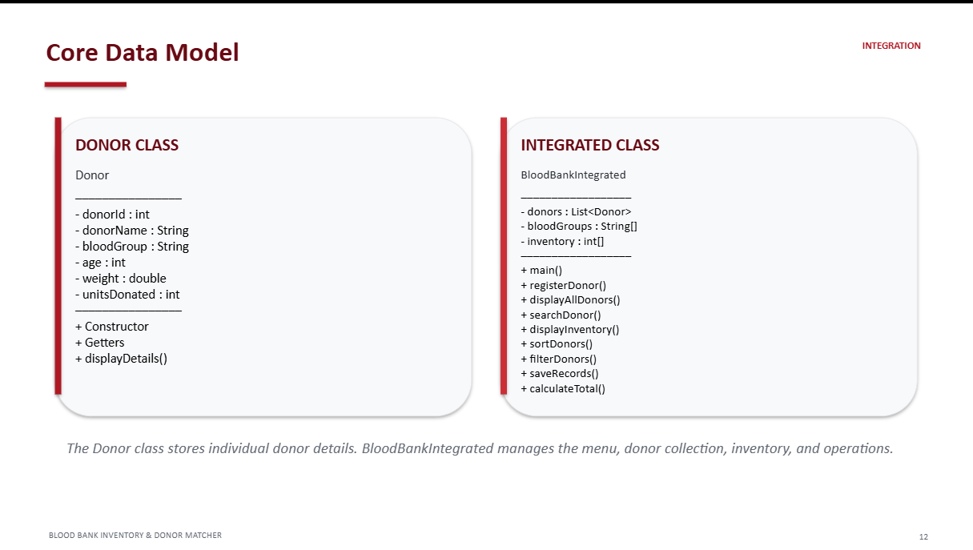
Core Data Model
INTEGRATION
DONOR CLASS
BLOOD BANK CLASS
Donor
──────────────
- donorId : String
- name : String
- bloodGroup : String
- age : int
- weightKg : double
──────────────
+ getters / display()
BloodBank
──────────────
- donors : collection of Donor
- stockByGroup : array or map
──────────────
+ registerDonor()
+ displayStock()
+ findMatches()
+ updateStock()
Private fields and clear class responsibilities support encapsulation and maintainable code.
BLOOD BANK INVENTORY & DONOR MATCHER
12

Slide 13
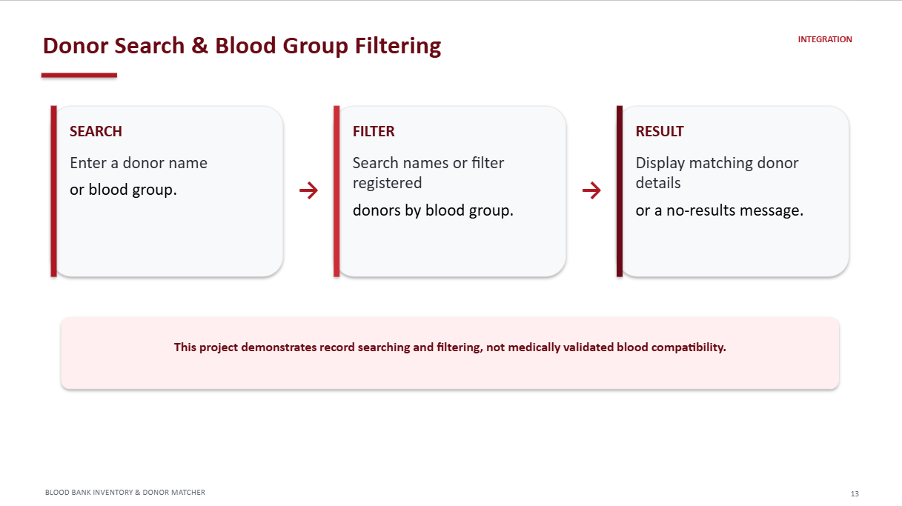
Donor Matching — Demonstration Logic
INTEGRATION
REQUEST
SEARCH
RESULT
Requested blood group
(e.g., O+)
Compare with stored
records and stock
Display possible records
or “Not available”
→
→
The program demonstrates record matching only. Actual donor suitability and blood compatibility must be confirmed by qualified blood-bank professionals.
BLOOD BANK INVENTORY & DONOR MATCHER
13

Slide 14
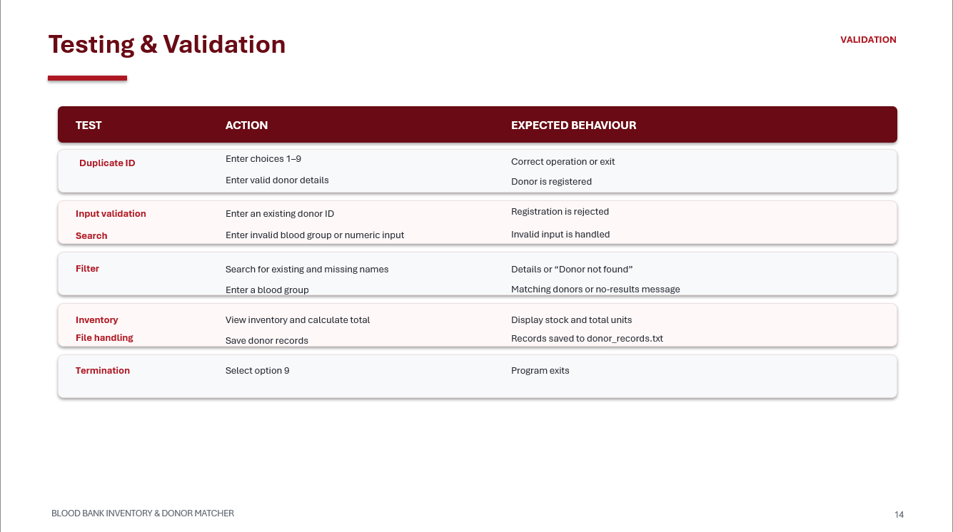
Testing & Validation
VALIDATION
TEST
ACTION
EXPECTED BEHAVIOUR
Menu
Choose each menu option
Correct action or exit
Input
Enter unexpected values
Handle input safely
Inventory
Display stock
Show each blood group clearly
Search
Try present and absent groups
Show matches or no-match message
Termination
Select Exit
Program stops cleanly
BLOOD BANK INVENTORY & DONOR MATCHER
14

Slide 15
Sample Console Output
DEMONSTRATION
Example of how the inventory option can appear in the console
========================================
BLOOD BANK INVENTORY & DONOR MATCHER
========================================
1. Register Donor
2. View Blood Stock
3. Find Donor Match
4. Exit
Enter choice: 2
Current Blood Stock (sample data)
A+ : 50 units
B+ : 40 units
O+ : 40 units
AB+ : 60 units
Total: 190 units
INVENTORY VIEW
The menu displays blood-group stock counts in a simple, readable format.
MATCHING OPTION
A request can be checked against available records and inventory.
BLOOD BANK INVENTORY & DONOR MATCHER
15

Slide 16
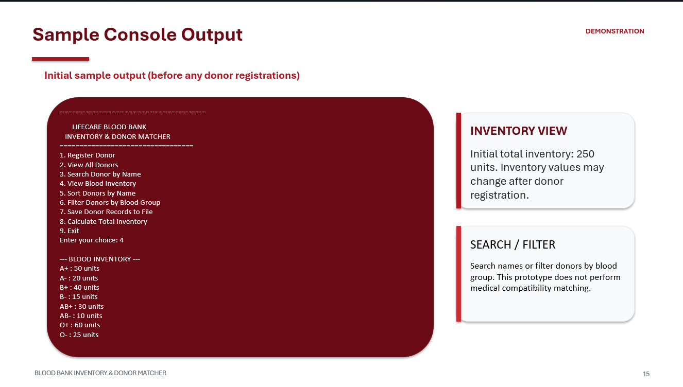

Slide 17
THANK YOU
Blood Bank Inventory & Donor Matcher
N. Joshi • Maahir • Krishna Chaitanya
KL Deemed to be University

